Slide 1
"Switch-on your savings today“
with
Providing Energy Solutions for Energy Costs Mitigation at Medium to Large Enterprises

Slide 2
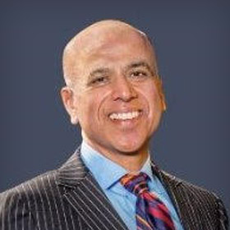
WHO WE ARE
The FVES team consists of senior industry leaders who have several decades of experience and expertise in development, financing, construction, management and operation of distributed energy assets ranging in size from several 100 kW to over 225 MW.
FVES is currently providing energy services that includes; energy assets management (Cogen plants ranging from 2 MW to over 100MW) and energy management services for clients ranging from large steel plant to nationwide grocery chain and a multinational food processor.
Atul Mahajan, CEO of FVES
Former CEO of Oshawa Power with experience developing/managing 2 – 100 MW scale energy assets. International speaker at energy conferences. Experienced leader in the electricity sector with broad industry knowledge
2

Slide 3
WHAT WE DO
Free assessment of energy solutions and business case development and innovative financing
Most large users of energy are already engaged with investigating potential opportunities to reduce their energy consumption.
At FVES, we can add value through:
No cost, review of already identified energy efficiency initiatives and develop required business case for executive teams.
At Client’s option, back such business cases with innovative financing solutions.
Apply custom analytical tools and deep industry knowledge to discover additional solutions to save utility costs and/or enhance operational resiliency
We will Qualify, Quantify your facilities’ energy solutions, including provide attractive financing, at your option
Manage and deploy a turnkey solution for you
We have experience; financing, constructing and managing 2 to 100 MW generators and of other innovative solutions that reduce your Utility bills and improve your bottom line
3

Slide 4
WHAT WE OFFER
Peak/energy management services
Option 1
Zero-down financing for a behind-the-meter electricity generation deployed on site
Option 2
We help a turnkey installation of your solution and you reap 100% of the savings
Custom energy savings solutions
Let us find the solution that fits your need, we know energy. We can also provide alternative financing options for our custom solutions
Expert on-going advisory services
We keep on top of all the latest ways to save money in Ontario and abroad. We leverage years of industry knowledge and experience through our trusted team to help you save money and enhance resiliency of your operations
4

Slide 5
CONTACT US FOR A FREE ASSESSMENT
Gaurav Aggarwal Analyst - Business Development
Phone: 416-669-2672 gaurava@fves.co | www.fves.co
5

Slide 6
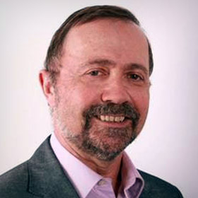
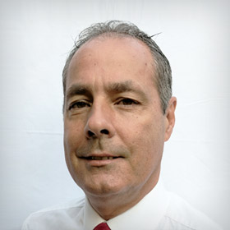
Team Bios
Peter Goldman
Senior Developer – Energy Solutions
With over 30 years of energy management experience in the industrial sector, Peter is responsible for growing, developing and executing site specific energy solutions, ranging from Combined Heat and Power (CHP) and Global Adjustment mitigation to on-site energy management.
Most recently Peter helped Toronto Hydro identify and evaluate CHP opportunities in all commercial sectors. He also managed the review of the CHP engineering reports and the corresponding IESO incentive applications. Prior to that he managed the industrial sales and marketing group at Enbridge Gas, responsible for development and delivery of an energy saving program to the industrial sector. Over the years Peter’s team delivered tens of millions of dollars of energy savings both gas and electricity for their customers.
Peter studied Mechanical Technology at Ryerson University. He is a Certified Energy Manager (CEM)
Fabio Schuler
SVP Operations
Fabio is a well-recognized leader with over 30 years of power industry experience, including 20 years in a senior leadership position managing the assets of a large Distributed Cogeneration Asset. Fabio’s vast and hands-on experience with distributed cogeneration plants (from 50 to 225 MW) encompasses; preparation of feasibility reports, implementing risk management processes, developing and implementing preventative and corrective maintenance procedures, operations, full oversight and responsibility for the P&L. Fabio is a team player with excellent leadership and technical skills. A dynamic and accomplished power plant specialist with a rich experience of management, commissioning, troubleshooting, operation and maintenance, Fabio is a registered Professional Engineer with the society of Professional Engineers of Ontario (PEO) and an Operating Engineer with Technical Standards and Safety Authority (TSSA)
Atul Mahajan
President & CEO
Atul has managed strategic growth and change management initiatives in diverse corporate cultures, including start-up venture and regulated utility. Most recently, as the CEO of an Ontario based electric Utility (Oshawa Power), Atul played a pivotal role in developing and implementing their strategic plan. For more than a decade, he was responsible for appropriate resource allocation to grow the Utility’s business in energy distribution/generation, district energy and wholesale telecom services. He has extensive experience in successfully identifying, negotiating and structuring strategic partnerships and alliances. Atul has keen interest, knowledge and experience, in developing, building, financing, constructing and commissioning distributed energy infrastructure projects. He is a frequent speaker at local and international conferences on emerging energy delivery solutions, such as distributed generation, district energy, solar plus storage and microGrids.

